Slide 1
Probability-Based Surgical Guidance Tool for Balloon Angioplasty/Stenting
John Lee
In collaboration with: Jason Szafron, Karthik Menon, Daniele Schiavazzi
8/4/2022

Slide 2
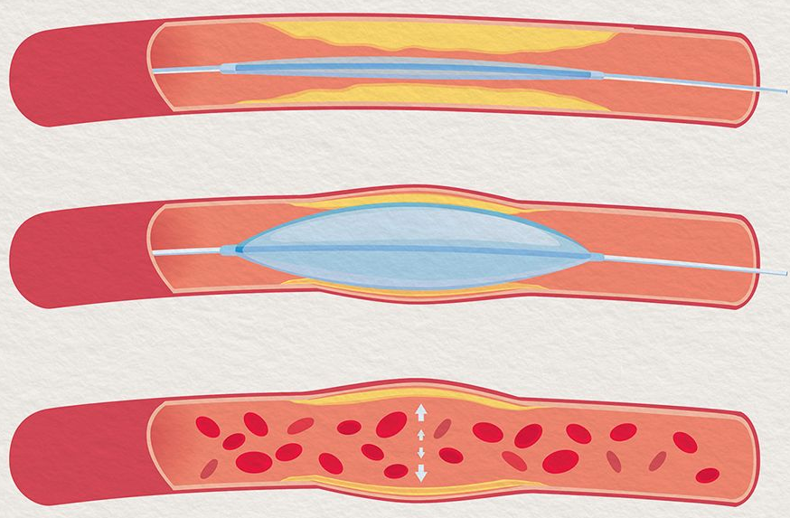
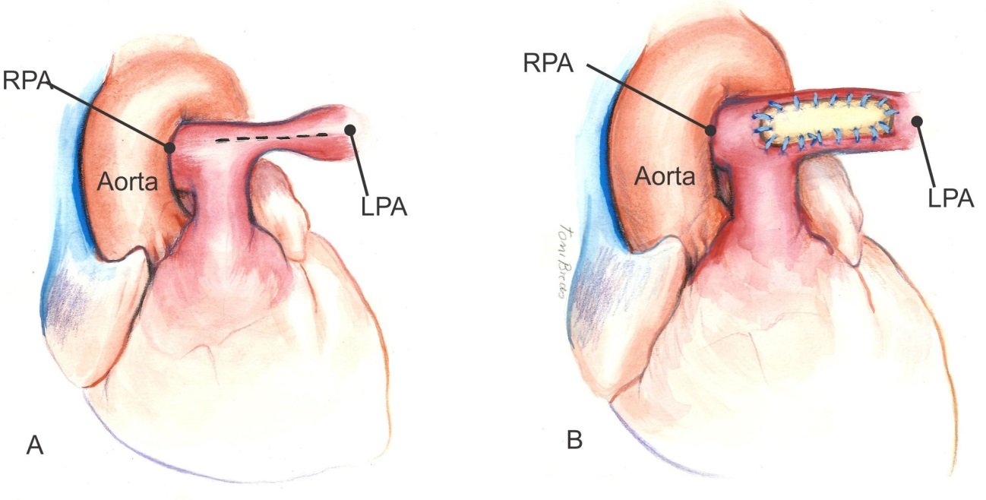
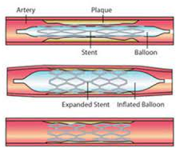
Background
Balloon
Surgical patch
Optimal treatment: Surgical reconstruction
Transcatheter treatment: Balloon Angioplasty Process w/ and w/o Stent
Notes:
Pulmonary Stenosis occurs in a variety of Pulmonary vascular diseases, such as Williams or Alagille syndrome
Previous literature has found that the optimal treatment for individuals with pulmonary stenosis is surgical pulmonary artery reconstruction, achieving long-term reduction of right ventricular pressures with low rates of morbidity, mortality, and reintervention.
However, signficant technical challenges associated with the surgery leave transcatheter interventions as standard-of-care despite suboptimal outcome such as persistent right ventricular hypertension and frequently necessitate reintervention
In cath-based treatments, clinicians must prioritize which lesions to balloon and/or stent, and in which order, knowing each procedure has an associated probability of success
A pressing need exists to develop new predictive virtual treatment planning tools to aid clinicians to identify optimal repair strategies, maximizing the probability of success for both short- and long-term outcomes.

Slide 3
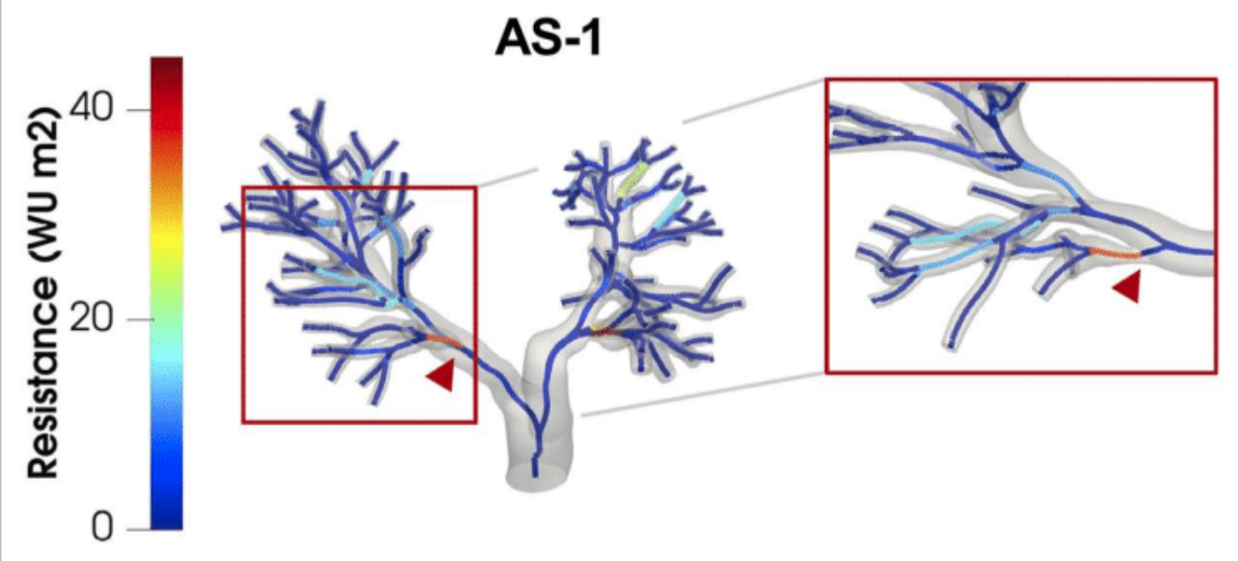
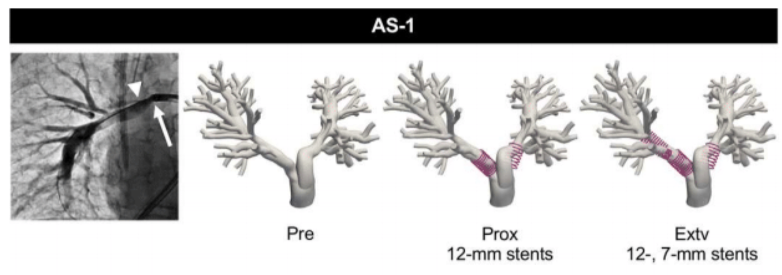
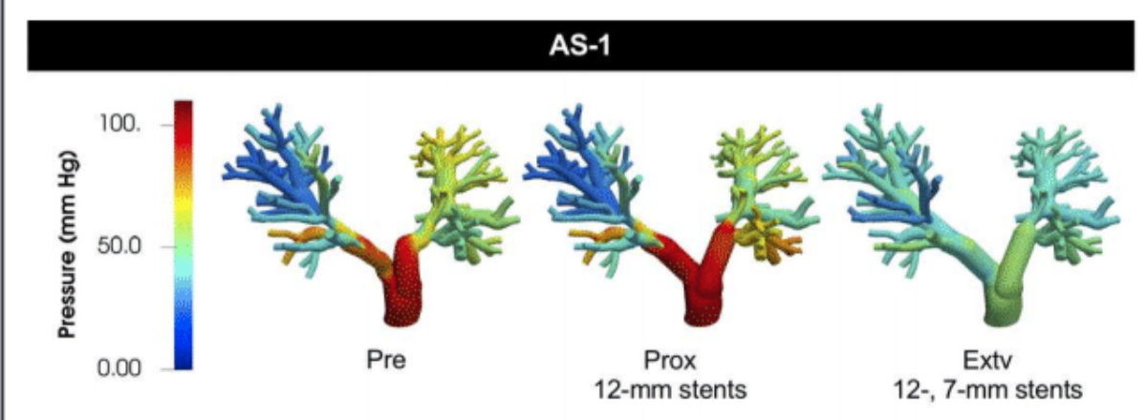
Previous Work
Lan et al., AHA Journal, 2022
Stenting Locations
Resistance Map
3D CFD simulations at peak systole
Notes:
Ingrid Lam, a former PhD student of Alison’s worked with modeling 6 Williams and Alagille Syndrome patients, utilizing 3D CFD simulations to model transcatheter postinterventional treatment.
She found, in the first image that Proximal stenting, which is the most common clinical practice is insufficient for treating pulmonary stenosis, and more extensive distal stenting is needed.
Furthermore, this shows the capabilities for 3D CFD simulations to accurately model hemodynamics in the presense of stenosis and posinterventional response.
Additionaly they proposed resistance maps to assist in identifying resistance hotspots and high impact stenosis regions

Slide 4
Motivation
Extend previous studies to include a probabilistic representation of a successful stenosis repair
Reduce computational expense of 3D simulations by utilizing 0D ROM models, enabling real-time virtual treatment
Implement a first prototype for a probability-based virtual treatment guidance tool.
Highlight the importance of minor pressure losses at bifurcations
Improve the accuracy of 0D formulations to model pulmonary anatomies with multiple generations

Slide 5
Project Goals/Steps
Given a 3D pulmonary model, construct an accurate lumped parameter (0D) low-fidelity representation
Identify n stenosis locations on the 0D model for repair.
Define a probabilistic model for repair success.
Identify locations to measure pressures and flow to characterize a successful outcome
Train a feed-forward neural network using 0D simulations to capture the changes in pressure/flow corresponding to various degrees of successful repair
Compute marginal/conditional probabilities to answer relevant clinical questions
Notes:
Just Read.

Slide 6
Overview
Tune healthy models
Artificially stenose healthy model at n points
Goal 1: Construct 0D models
Goal 2: Detecting stenotic regions
Goal 3&4: Talk with a clinician
Goal 2
Use given RCRs for stenosis models
Identify n points of stenosis
Notes:
Visualization of structure: Two paths to take, Tune healthy model, artificial stenose it, or use given RCR’s (usually tuned to some clinical measurements) and identify n points of stenosis

Slide 7
Goal 1
Construct ROM from 3D model
Notes:
Organize in terms of goals

Slide 8
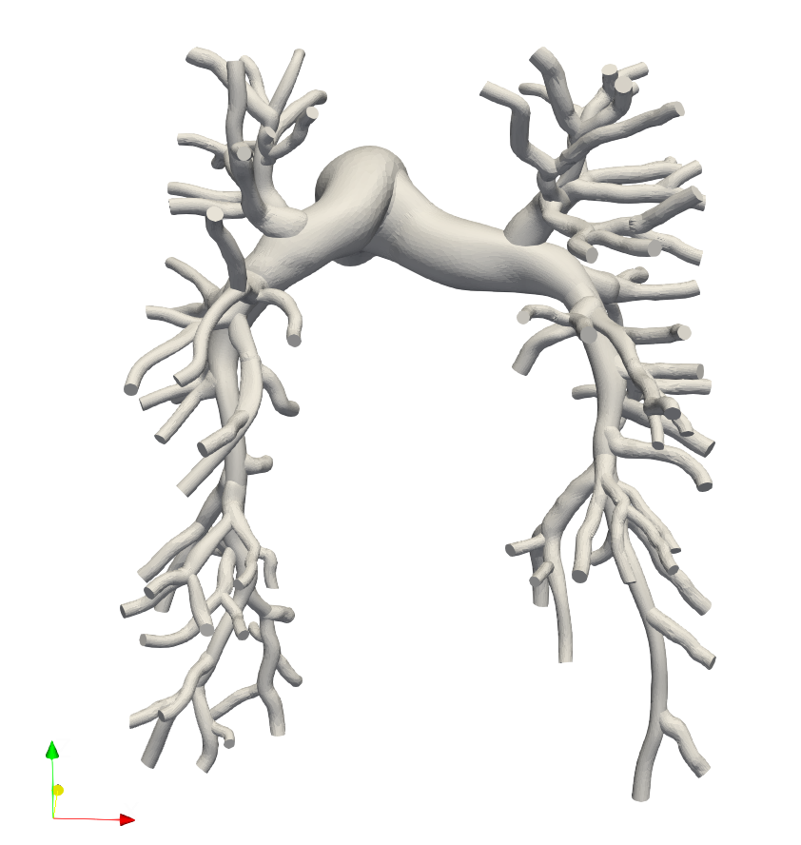
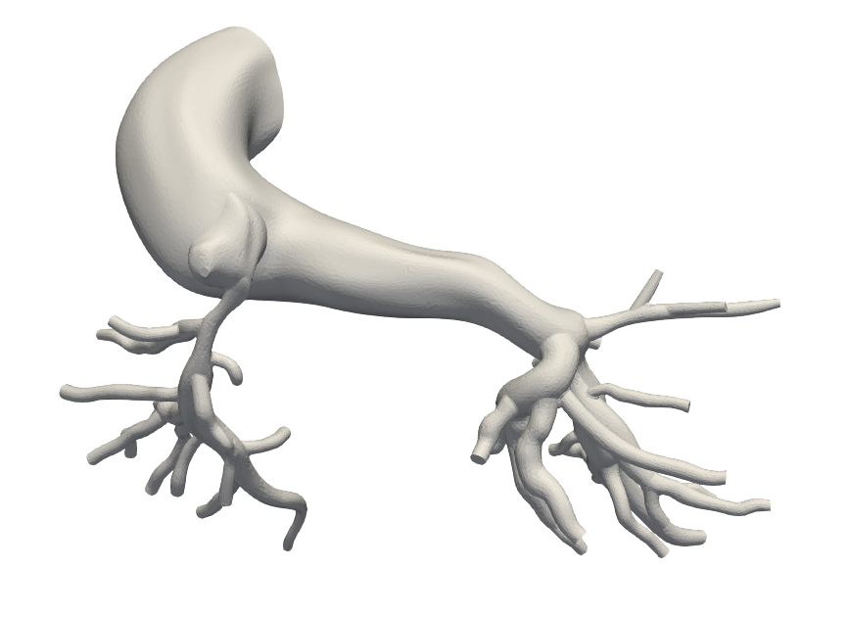
Model Gathering
Gather both healthy and stenosis
9 Healthy (VMR)
2 Alagille (VMR)
3 A&W (Lan et al.)
Working models
3 Healthy
2 Stenosis
Problems with VMR models
Not finely meshed enough to generate centerlines
Insufficiently blended (unable to load faces for blending)
0080_0001 (Healthy)
0118_1000 (Alagille)
Notes:
Read it off

Slide 9
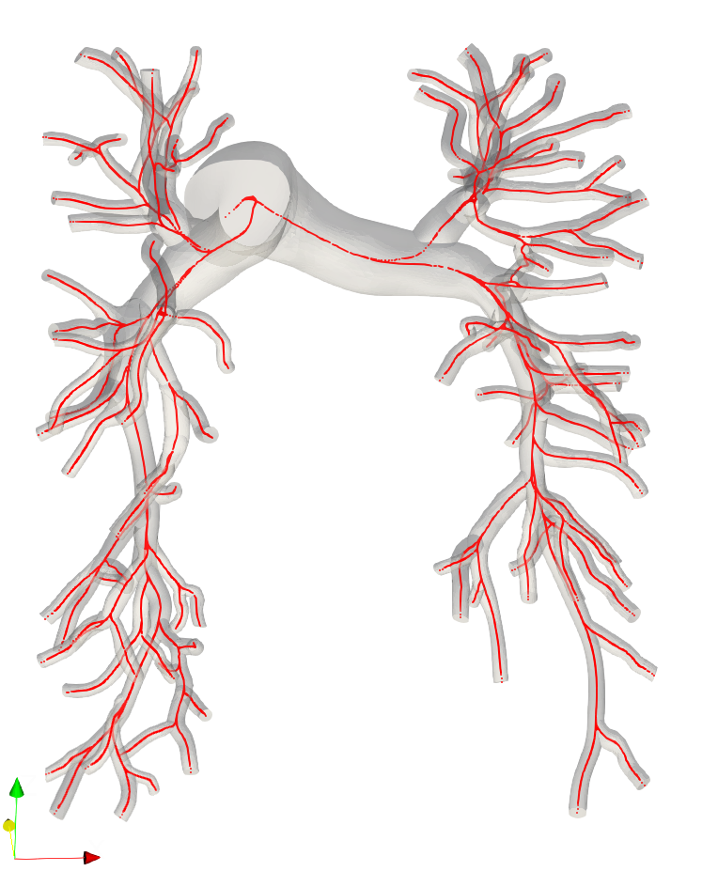
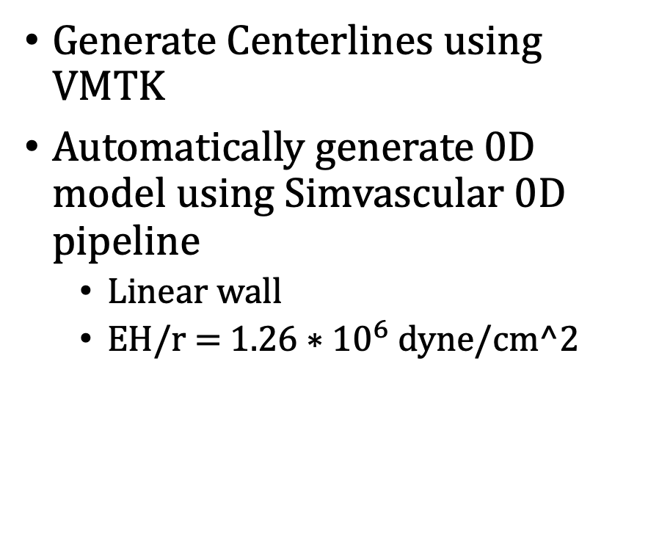
Centerline/0D Model Generation
Generate Centerlines using VMTK
Automatically generate 0D model using Simvascular 0D pipeline
Linear wall
EH/r = $1.26∗{10}^{6}$ dyne/cm^2
Notes:
Read

Slide 10
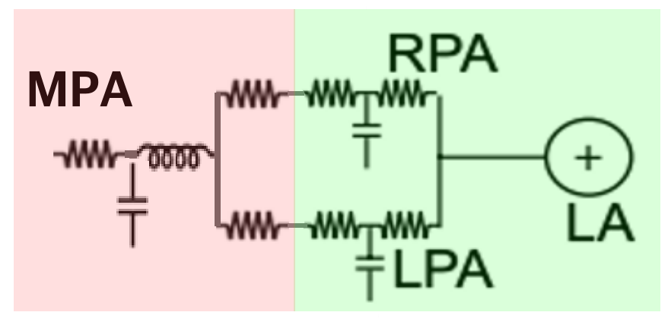
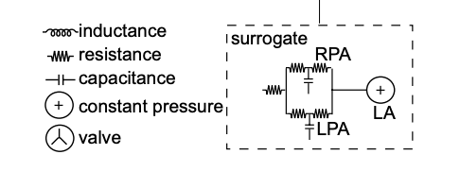
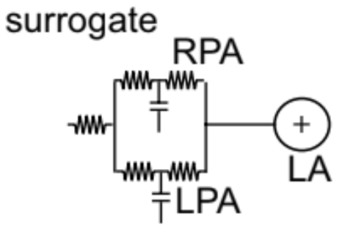
Healthy Models BC tuning
Yang et. al. 2019 Surrogate model (Modified)
Original
Solver-determined RCL values.
RPA/LPA resistances computed using resistances in series and parallel
Tunable RCR boundary conditions for LPA and RPA, with constant capillary wedge pressure of 7 mmHg
Notes:
We take a modified surrogate tuning model used by Weiguang in 2019.
We use solver computed RCL values for the MPA, and represent the RPA/LPA trees by a resistance computed using resistances in series and parallel
For actual tunable parameters, we set RCR boundary conditions for the RPA and LPA respectfully with a target capillary wedge pressure of 7

Slide 11
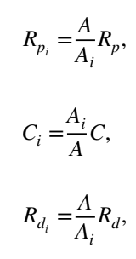
Optimization Procedure
Procedure
Receive a segmented 0D model w/ dummy RCRs
Compute RPA/LPA R values only using Poiseuille resistance values
Optimize until goal is reached
Split RCRs, run model once
Recompute RPA/LPA R values, including stenosis coefficients using approximate flow from run
Optimize until goal is reached
Goal
Ideal: ObjFunc < .01 (1% error)
Early stop: Patience (5), Patience Tolerance (1e-6)
Split RCRS (Yang et. al. 2019)

Slide 12
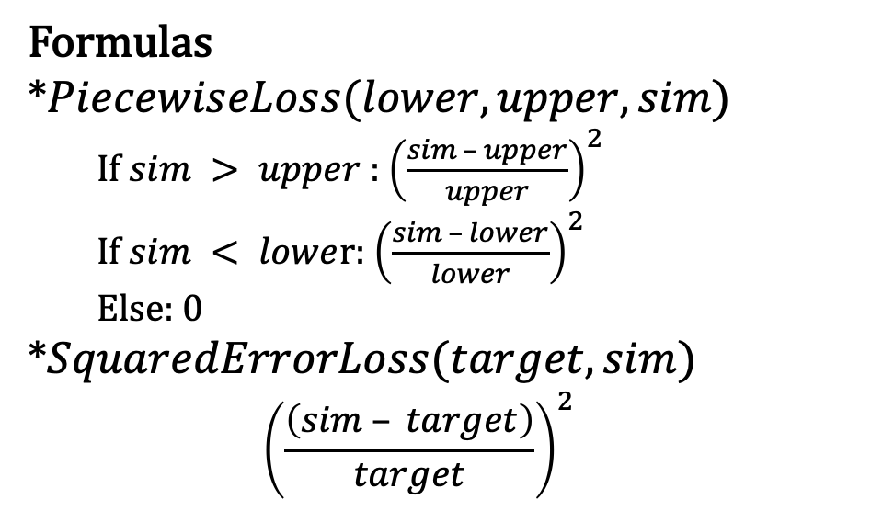
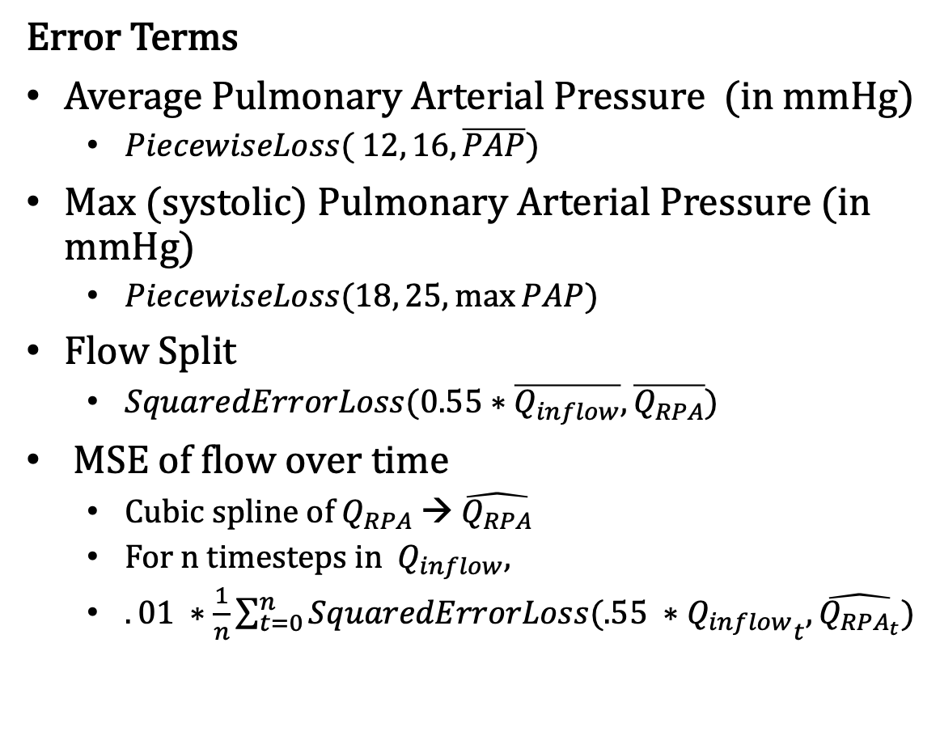
Objective Function
Error Terms
Average Pulmonary Arterial Pressure (in mmHg)
$PiecewiseLoss( 12, 16, \overline{PAP})$
Max (systolic) Pulmonary Arterial Pressure (in mmHg)
$PiecewiseLoss(18, 25,\max{PAP})$
Flow Split
$SquaredErrorLoss(0.55∗\overline{Q_{inflow}}, \overline{Q_{RPA}})$
MSE of flow over time
Cubic spline of $Q_{RPA}$→ $\hat{Q_{RPA}}$
For n timesteps in $Q_{inflow}$,
$.01 ∗\frac{1}{n}\sum_{t=0}^{n}{SquaredErrorLoss(.55 ∗{Q_{inflow}}_{t},\hat{Q_{RPA_{t}}})}$
Formulas
*$PiecewiseLoss(lower, upper, sim)$
If $sim > upper$: ${\left(\frac{sim – upper}{upper}\right)}^{2}$
If $sim < lowe$r: ${\left(\frac{sim – lower}{lower}\right)}^{2}$
Else: 0
*$SquaredErrorLoss(target, sim)$
$${\left(\frac{\left(sim – target\right)}{target}\right)}^{2}$$

Slide 13
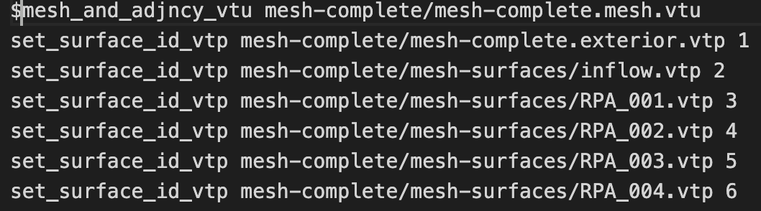
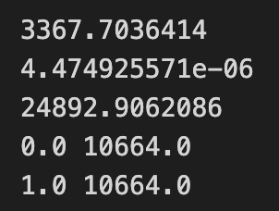
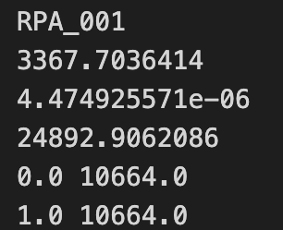
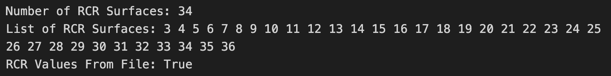
Stenosis Model BC
Only use models where an rcrt.dat file is provided for 3D simulations
Must be changed from 3D ordering to 0D mapping organization
Create mapping using .svpre file
Takes in 3D RCR
Maps to 0D
Retrieve order using solver.inp file
Notes:
Simple script taking in 3D RCRS, solver file and svpre file to map cap names back to 0D (assuming the models are identical)

Slide 14
Goal 2
Identify Stenotic Regions
Notes:
Organize in terms of goals

Slide 15
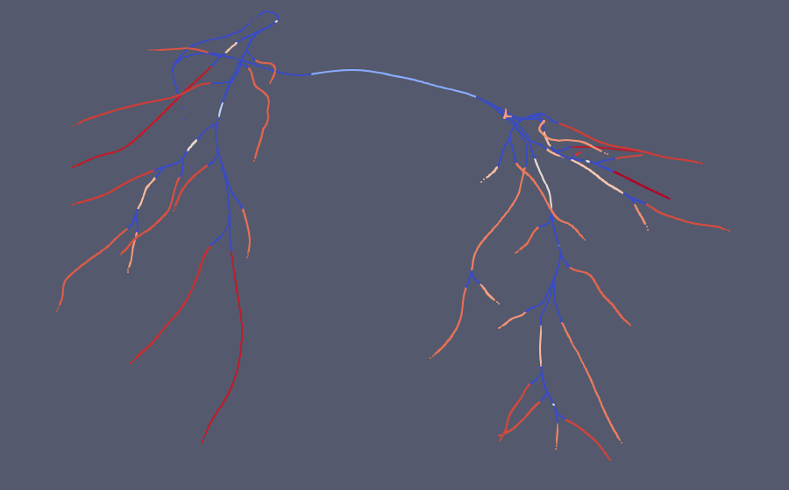
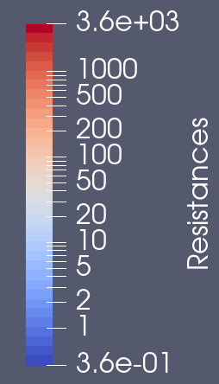
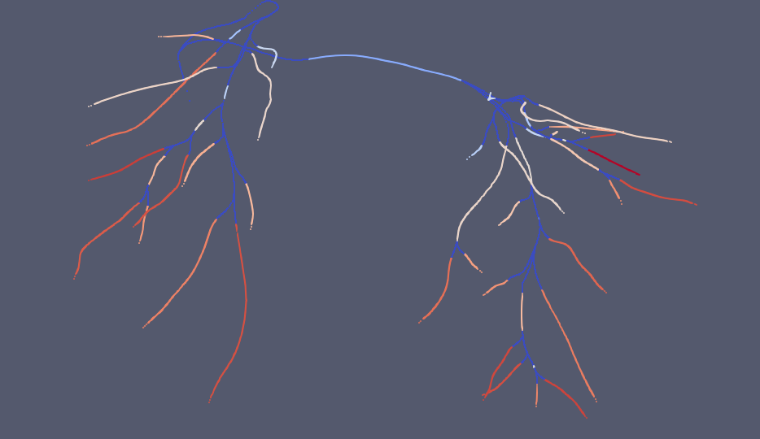
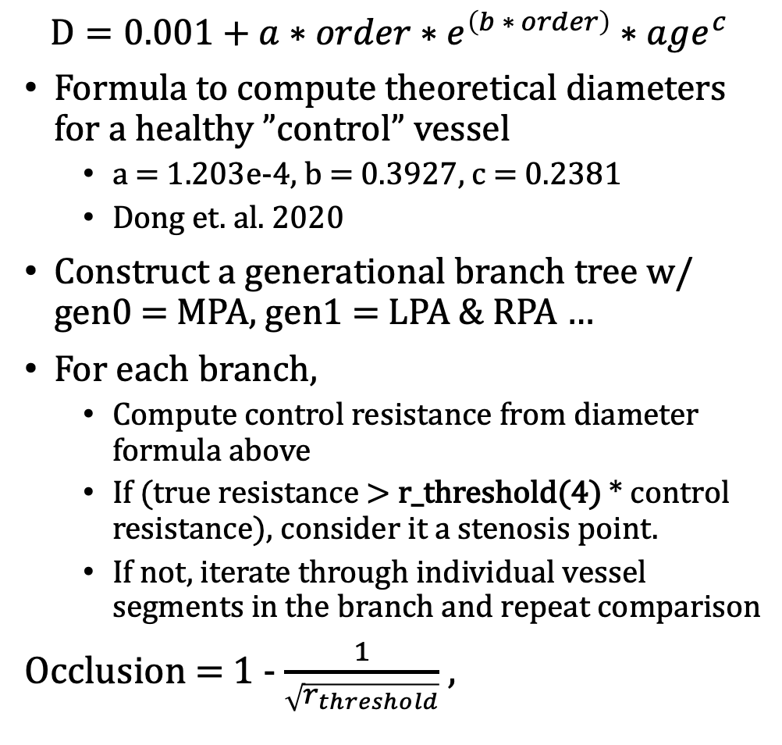
Identifying Stenosis
Pre-Treatment Resistance Map
$$D=0.001+a∗order∗e^{\left(b ∗ order\right)}∗age^{c}$$
Formula to compute theoretical diameters for a healthy ”control” vessel
a = 1.203e-4, b = 0.3927, c = 0.2381
Dong et. al. 2020
Construct a generational branch tree w/ gen0 = MPA, gen1 = LPA & RPA …
For each branch,
Compute control resistance from diameter formula above
If (true resistance > r_threshold(4) * control resistance), consider it a stenosis point.
If not, iterate through individual vessel segments in the branch and repeat comparison
Occlusion = 1 - $\frac{1}{\sqrt{r_{threshold}}}$ ,
Post-Treatment Resistance Map

Slide 16
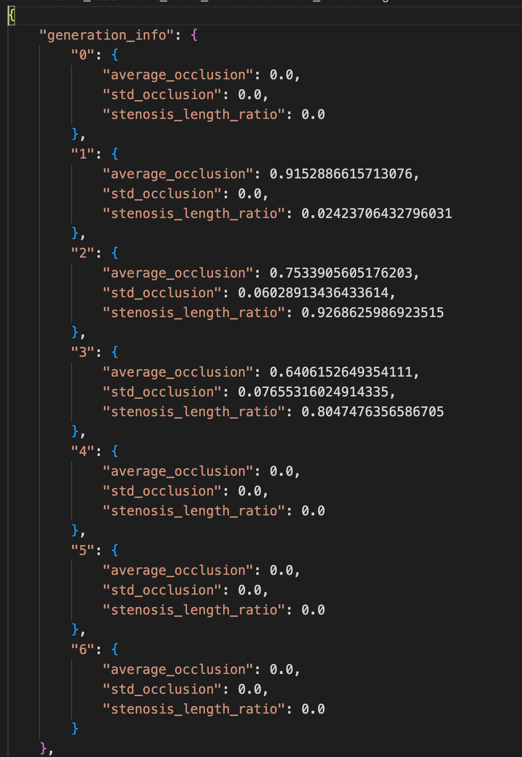
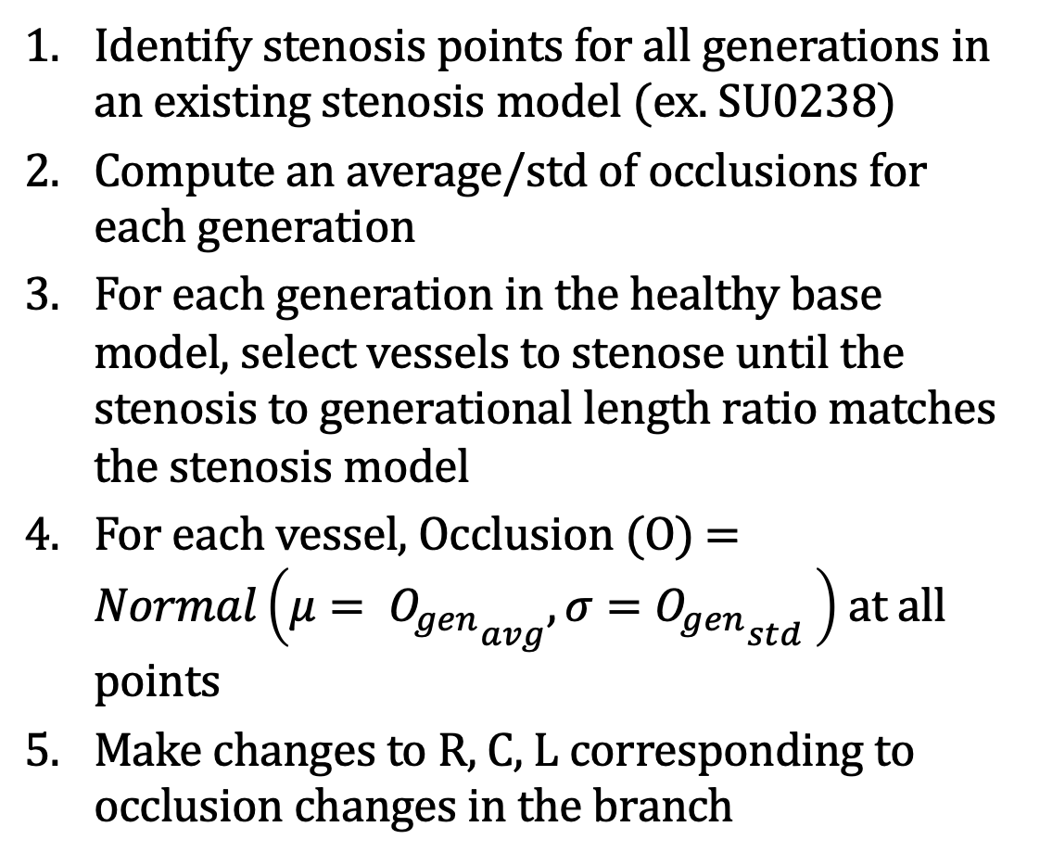
Artificial Stenosis – Healthy Models
Identify stenosis points for all generations in an existing stenosis model (ex. SU0238)
Compute an average/std of occlusions for each generation
For each generation in the healthy base model, select vessels to stenose until the stenosis to generational length ratio matches the stenosis model
For each vessel, Occlusion (O) = $Normal\left(μ= {O_{gen}}_{avg},σ={O_{gen}}_{std} \right)$ at all points
Make changes to R, C, L corresponding to occlusion changes in the branch
Config File for SU0238
Notes:
We are considering making a change, so rather than probability based, we will try to match stenosis according to one of Ingrid’s models and observe the change.

Slide 17
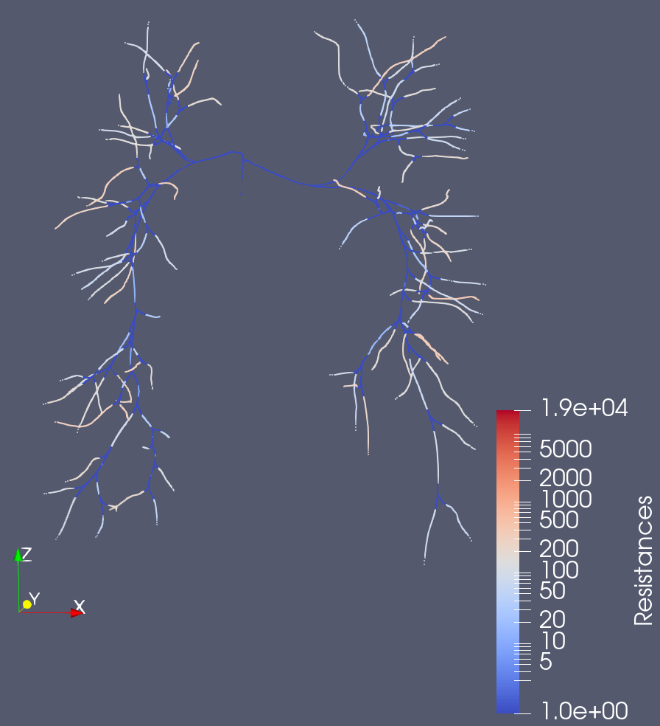
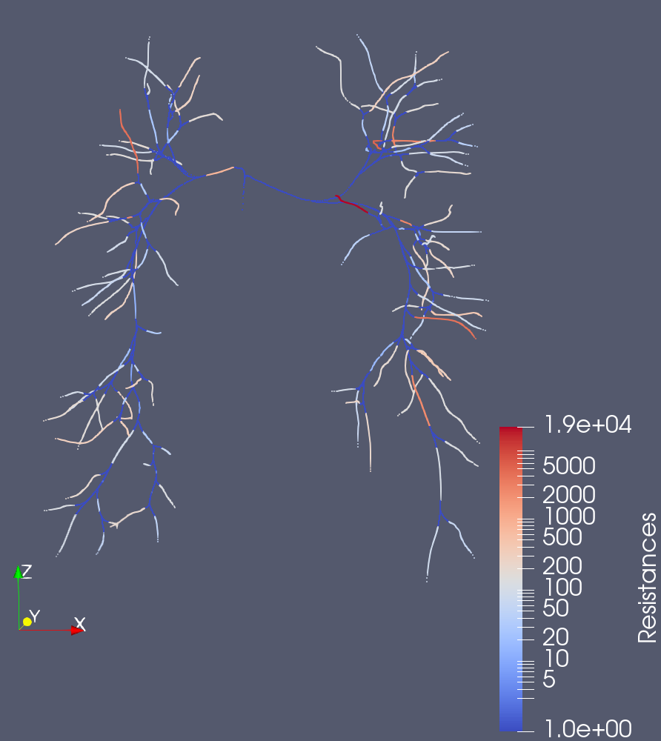
Artificial Stenosis Effects
Resistance Map: Before
Resistance Map: After

Slide 18
Code
On Github at: https://github.com/JohnDLee/StenosisTool.git
Let me know if you need more detail

Slide 19
Junction Modeling
Notes:
Organize in terms of goals

Slide 20
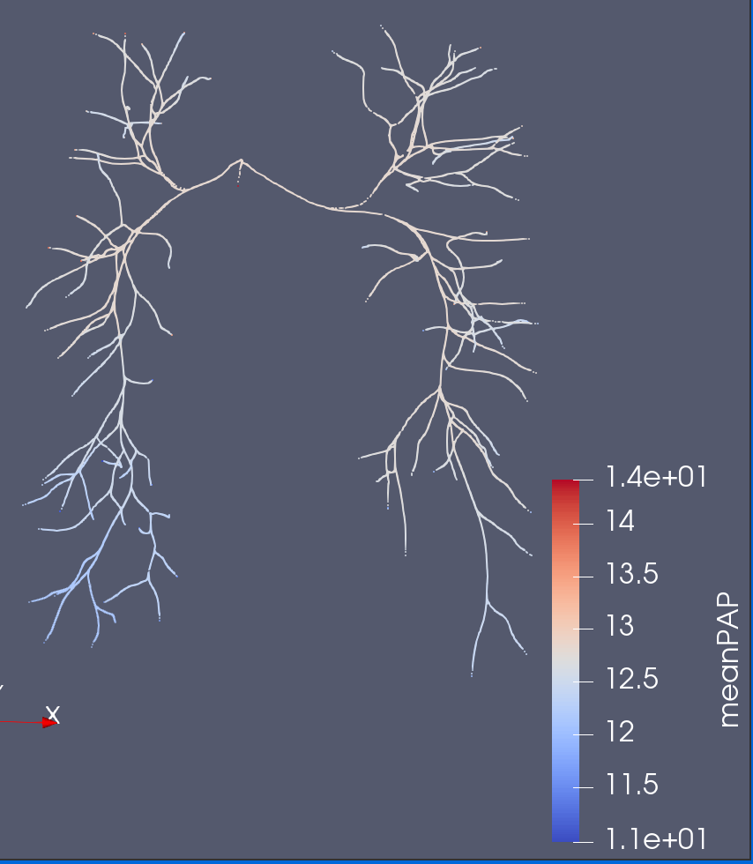
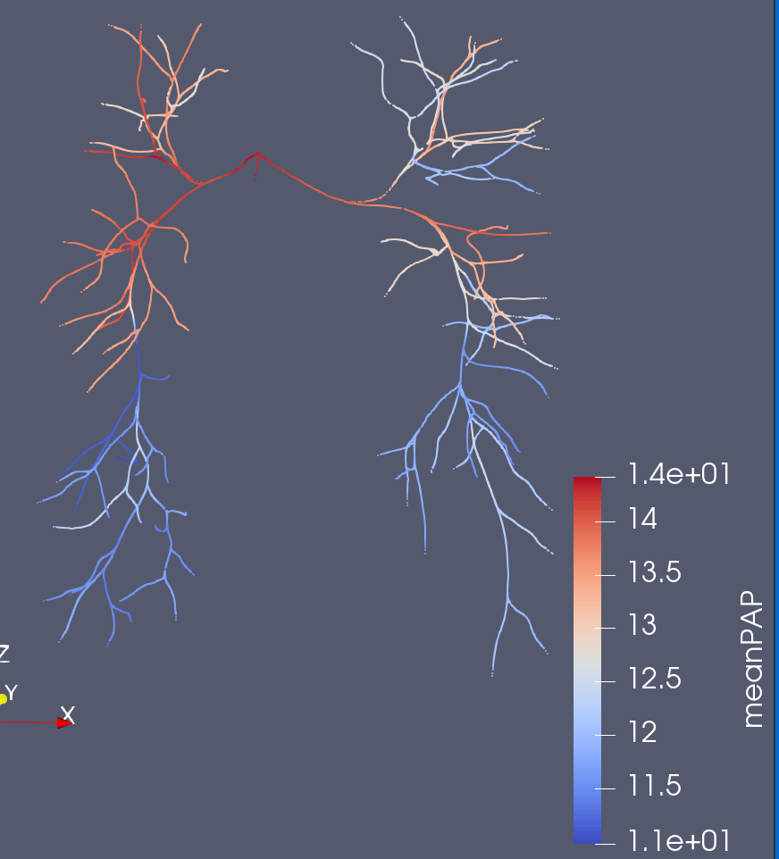
0D Junction Handling
0D
3D
0D simulations fail to capture the pressure drop
Previously noted that the significant number of junctions in pulmonary models induced a higher error in 0D simulations than other anatomies

Slide 21
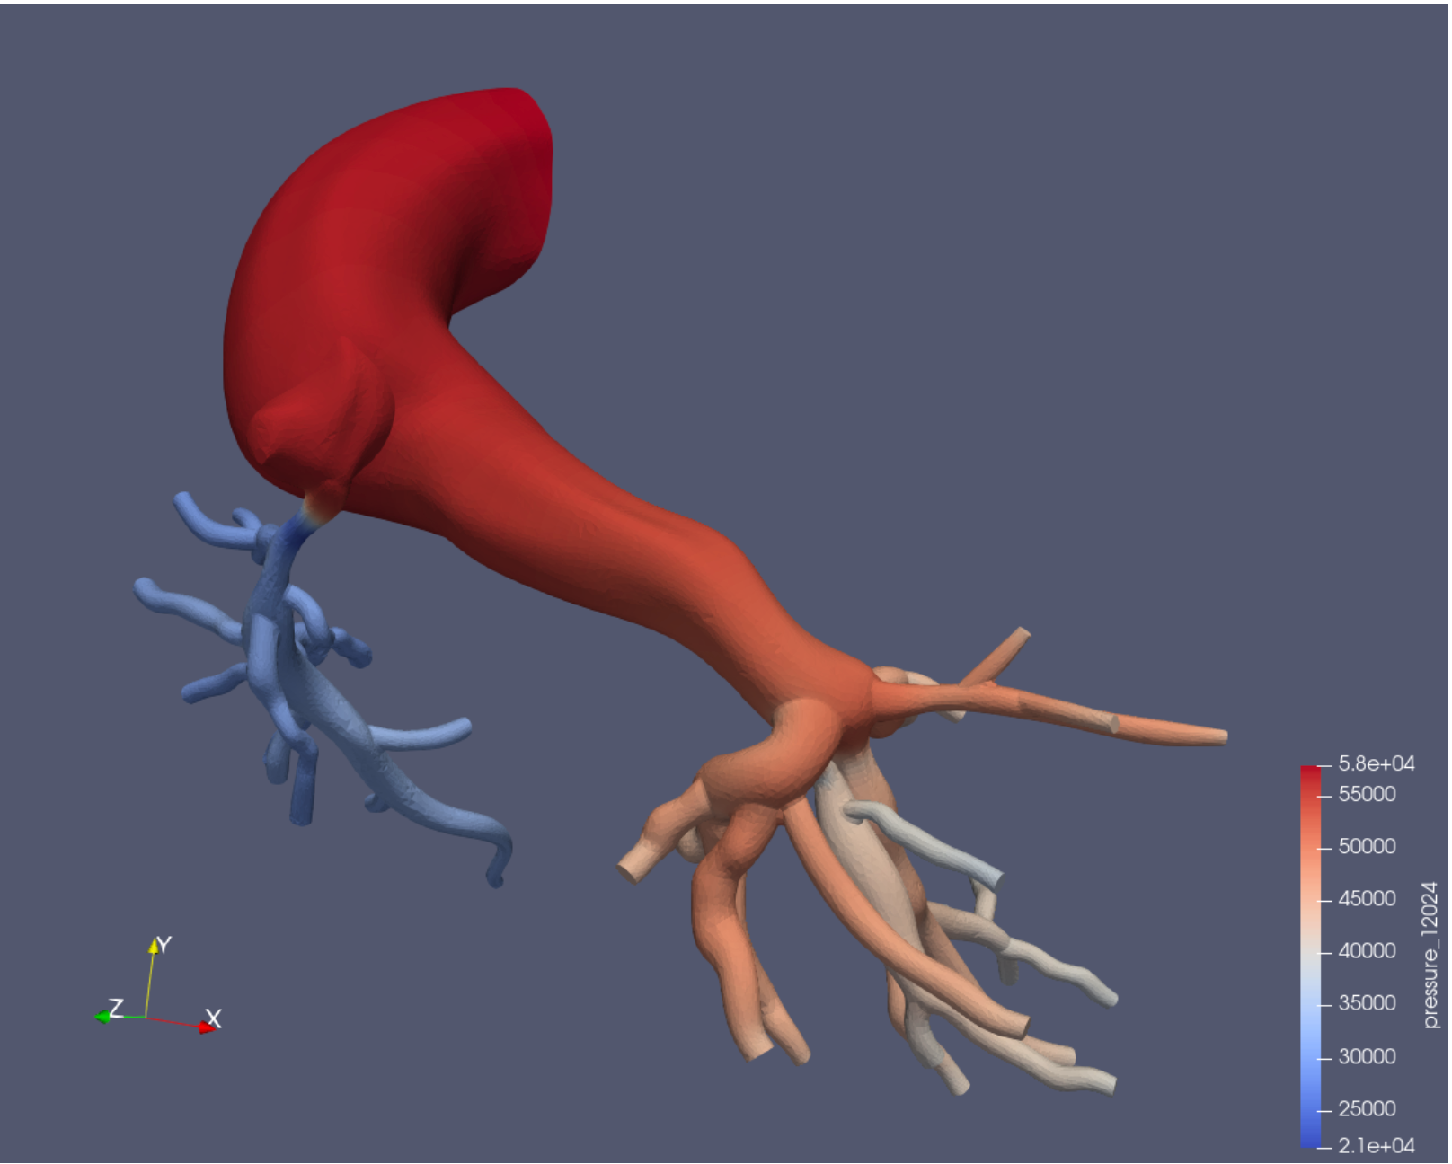
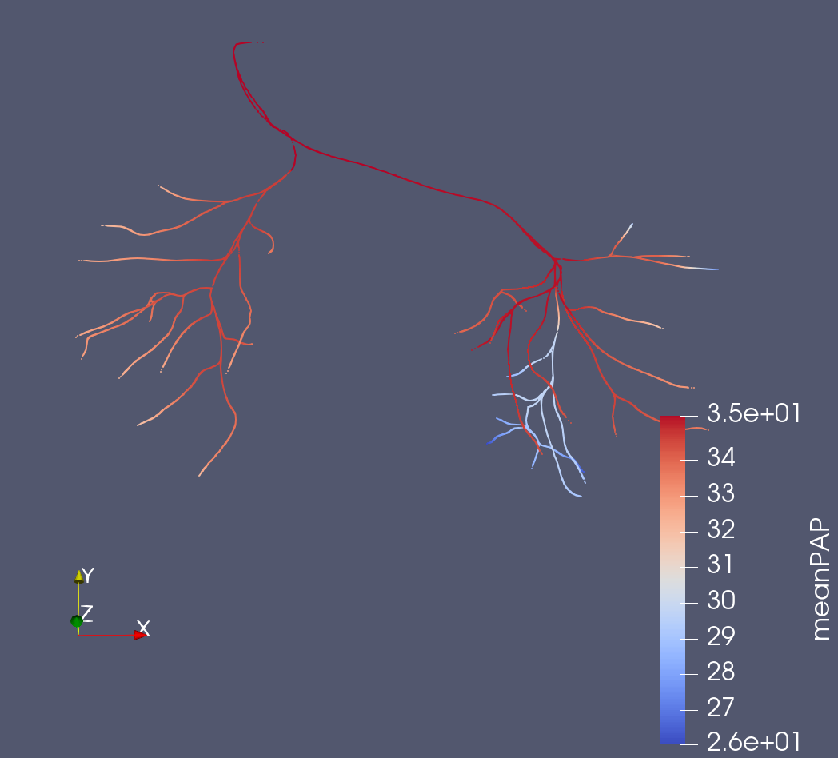
Junction Stenosis Problem
0D Junctions only conserve static pressure and flow
Unable to capture any pressure drop occurring within junction

Slide 22
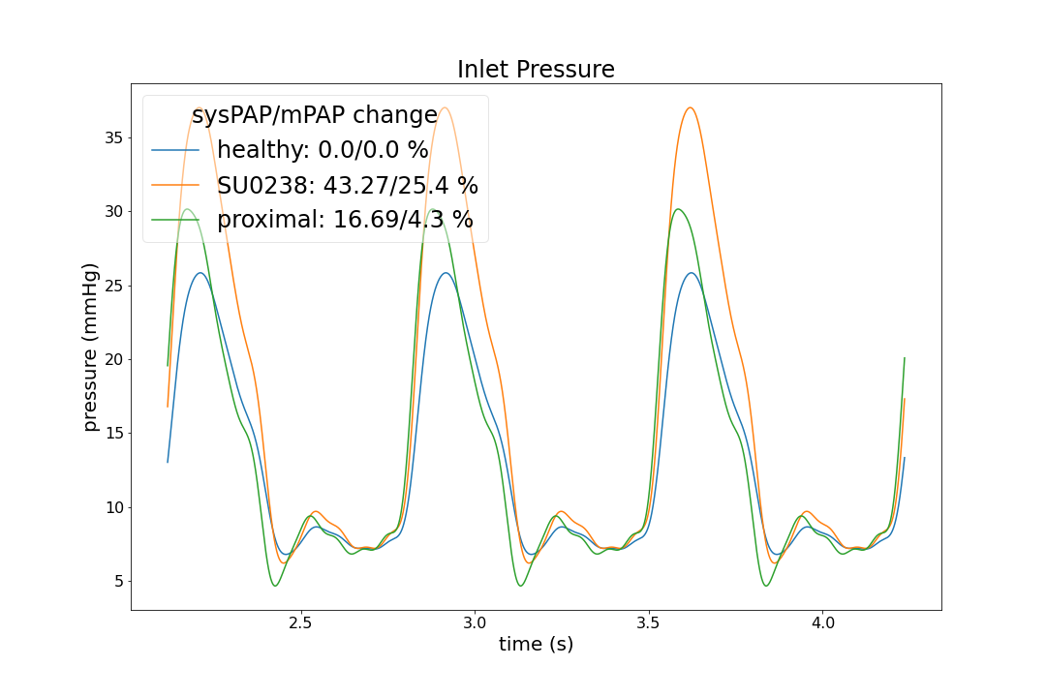
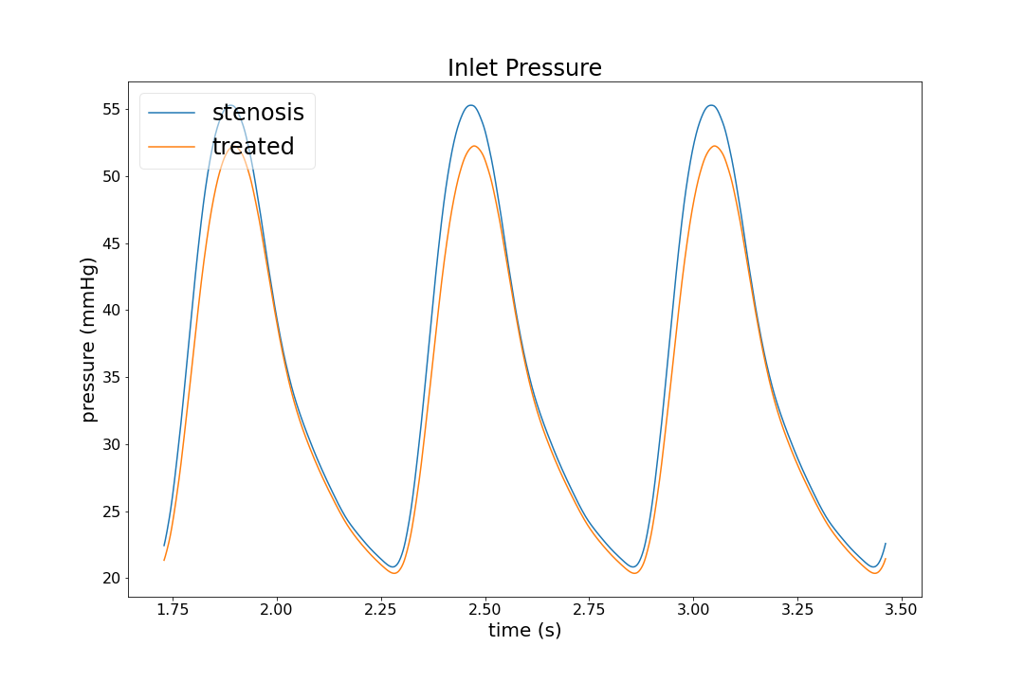
Unresponsive Treatment/Artificial Stenosis
Artificial Stenosis (0080_0001)
Treatment (0118_1000)
Minimal effect of 75% occlusion (MPA/LPA/RPA) proximal stenosis
Hardly effective even after stenosing 50% of all vessels by > 50% occlusion
Negligible change despite reducing resistances of nearly 50% vessels by more than 4x

Slide 23
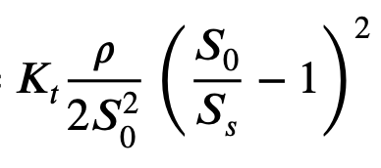
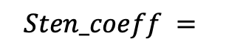
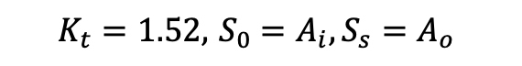
Potential Solutions
$$Sten_coeff =$$
$$K_{t}=1.52, { S}_{0 }=A_{i}, S_{s}=A_{o}$$
Junction Coefficients (Implemented)
Use vessel stenosis coefficient formula
Take inlet area of junction, and one outlet area, adding junction coeff to downstream vessel
More extensive/ML Junction solution
Currently Opened Issue on GitHub
3D-optimization
Tune 0D RCL’s to match pressure drop in a 3D model
Project-specific solution
← Original
Stenosis coefficient is small
Junction Coeff →
Additional Junction coefficient is much larger

Slide 24
Preliminary Results
Notes:
Organize in terms of goals

Slide 25
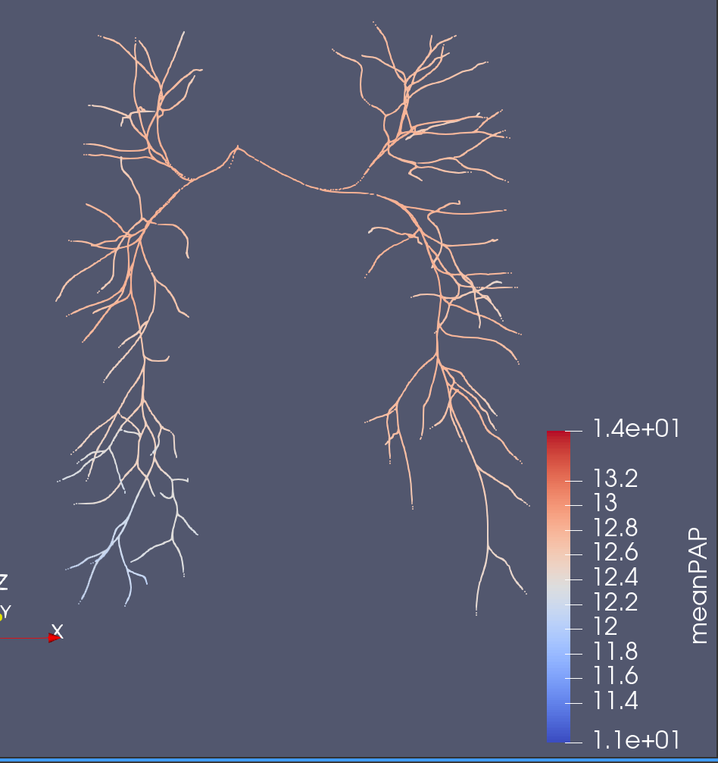
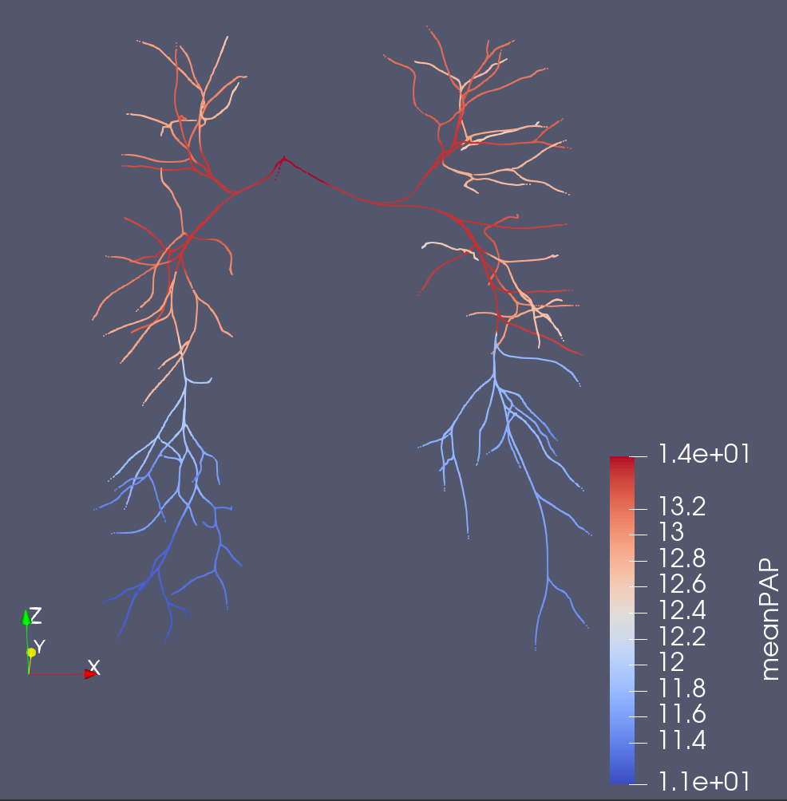
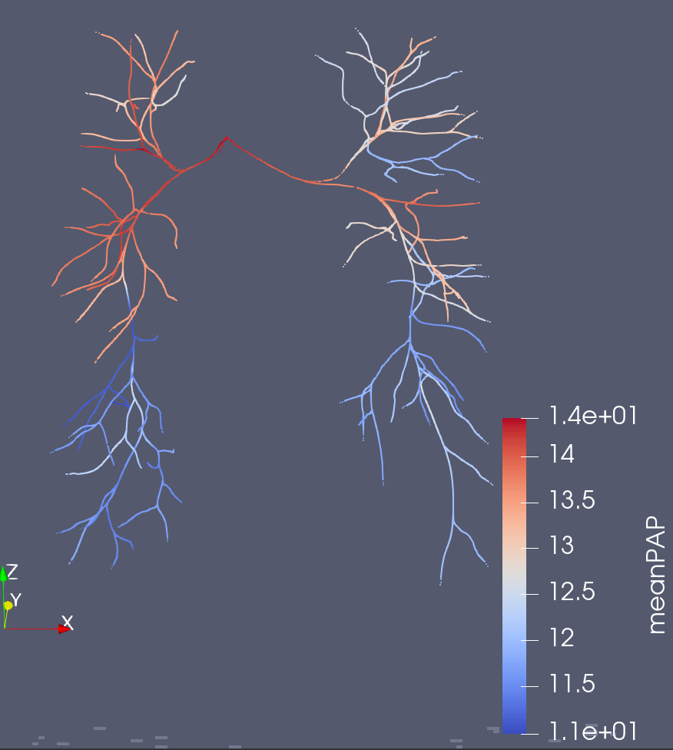
0080_0001 (meanPAP)
Original Solver
Junction Coefficient Solver
3D
Better Capture of the ~3 mmHg Pressure Drop

Slide 26
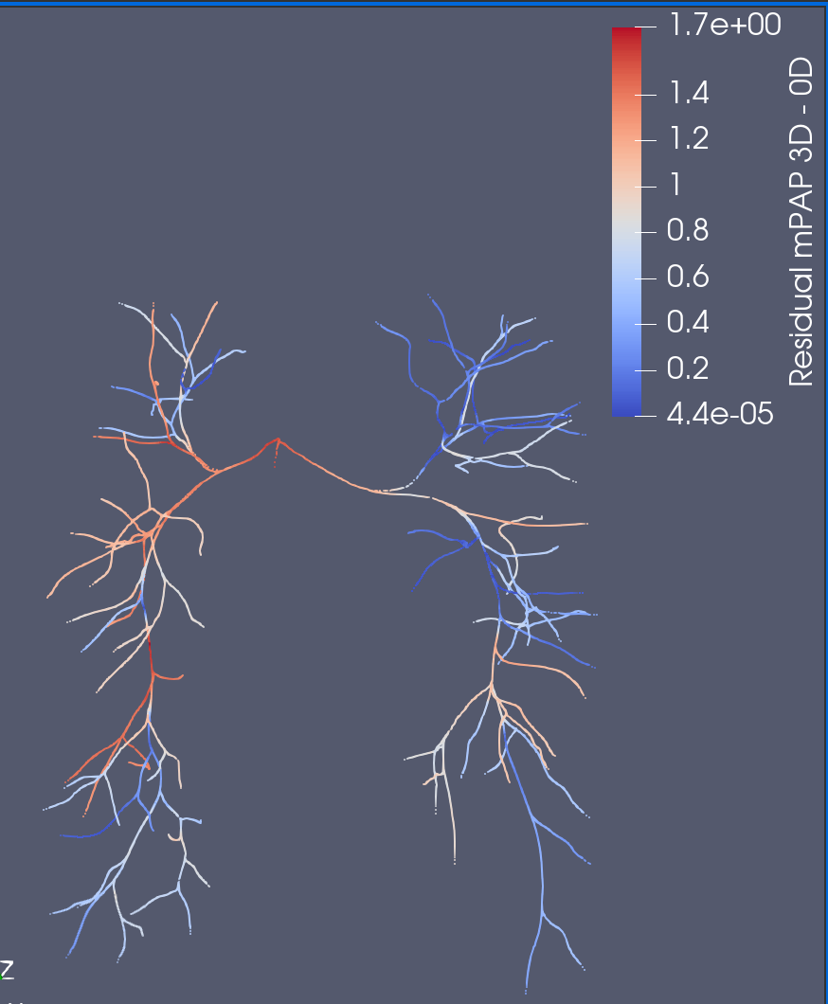
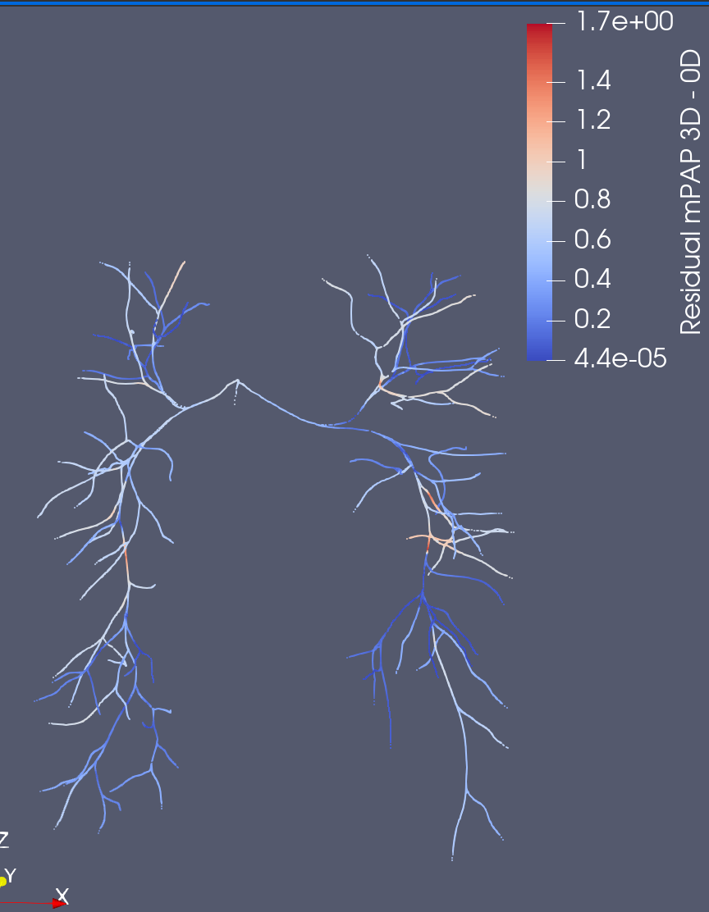
0080_0001 (Residual meanPAP)
Original Solver
Junction Coefficient Solver
Much more consistent

Slide 27
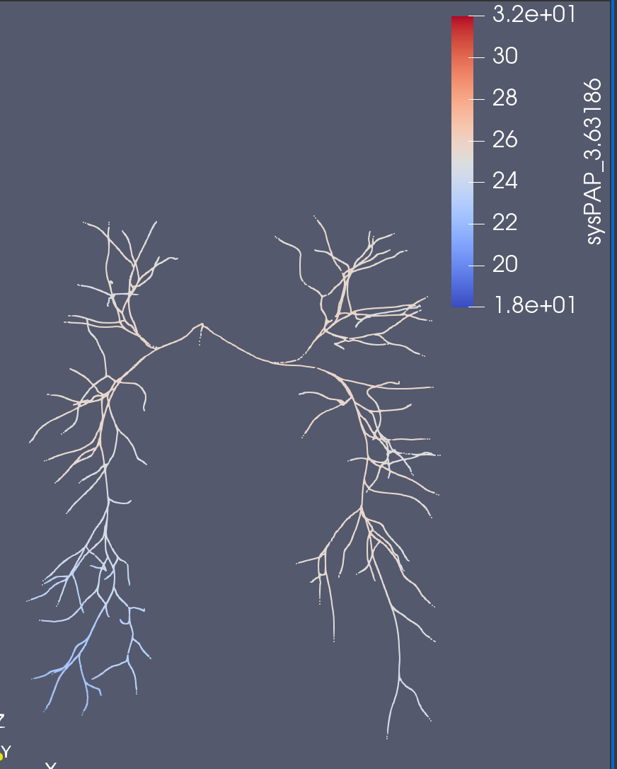
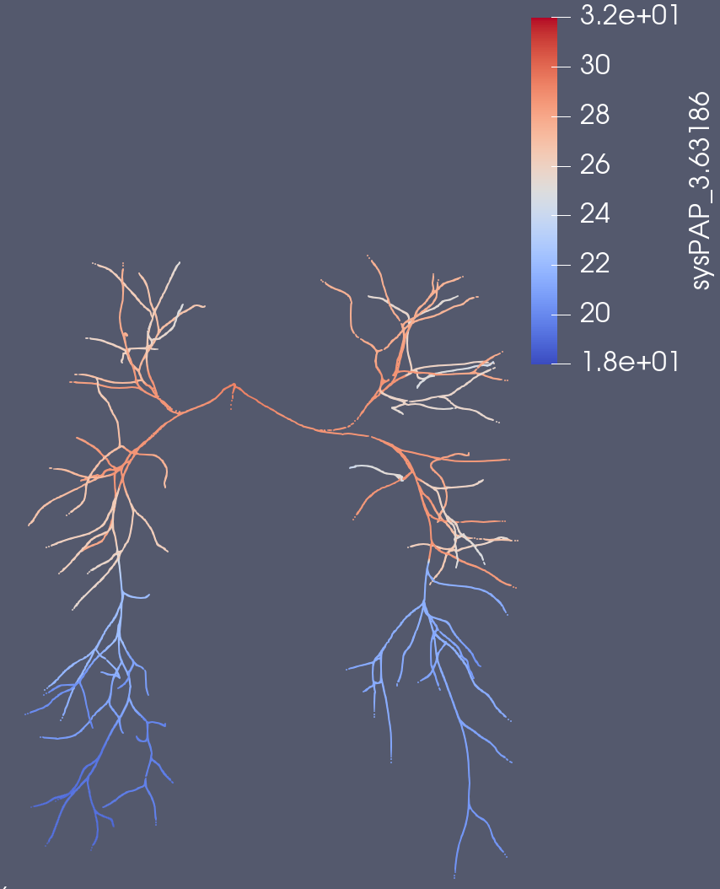
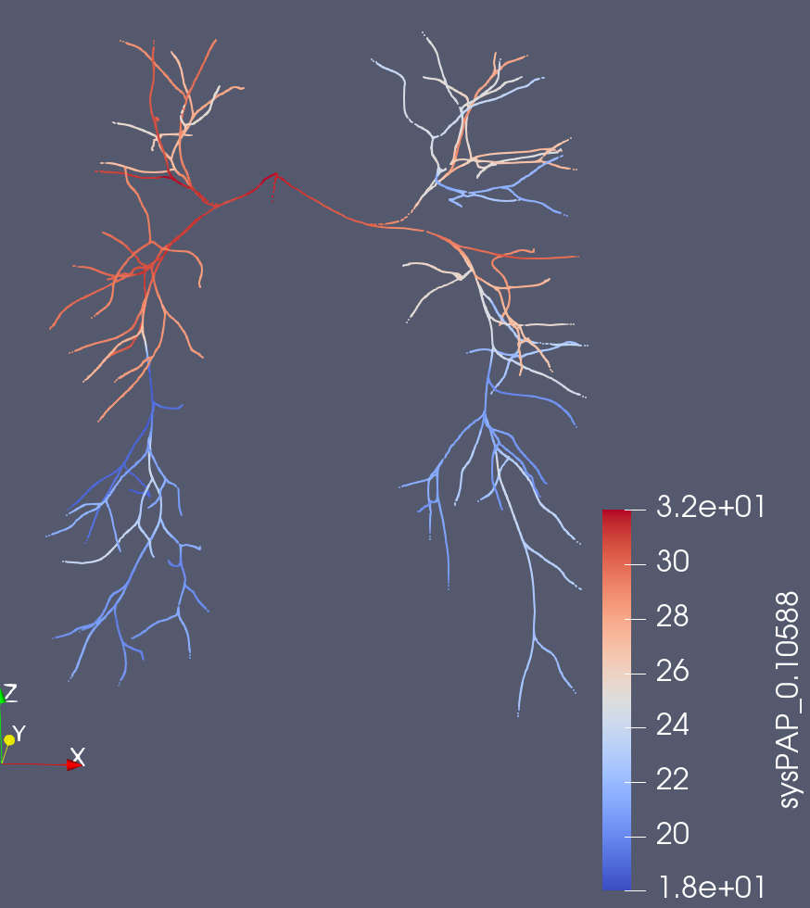
0080_0001 (sysPAP)
Original Solver
Junction Coefficient Solver
3D

Slide 28
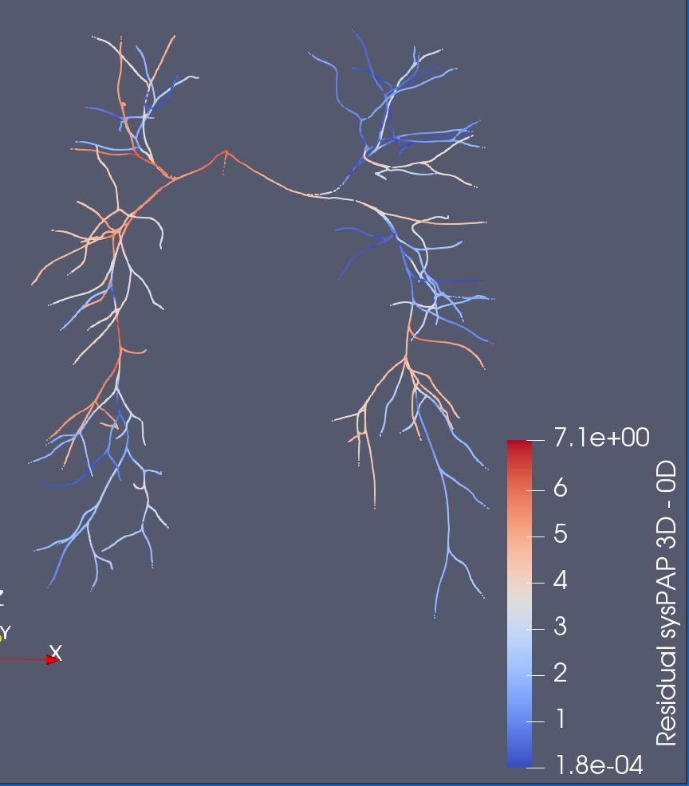
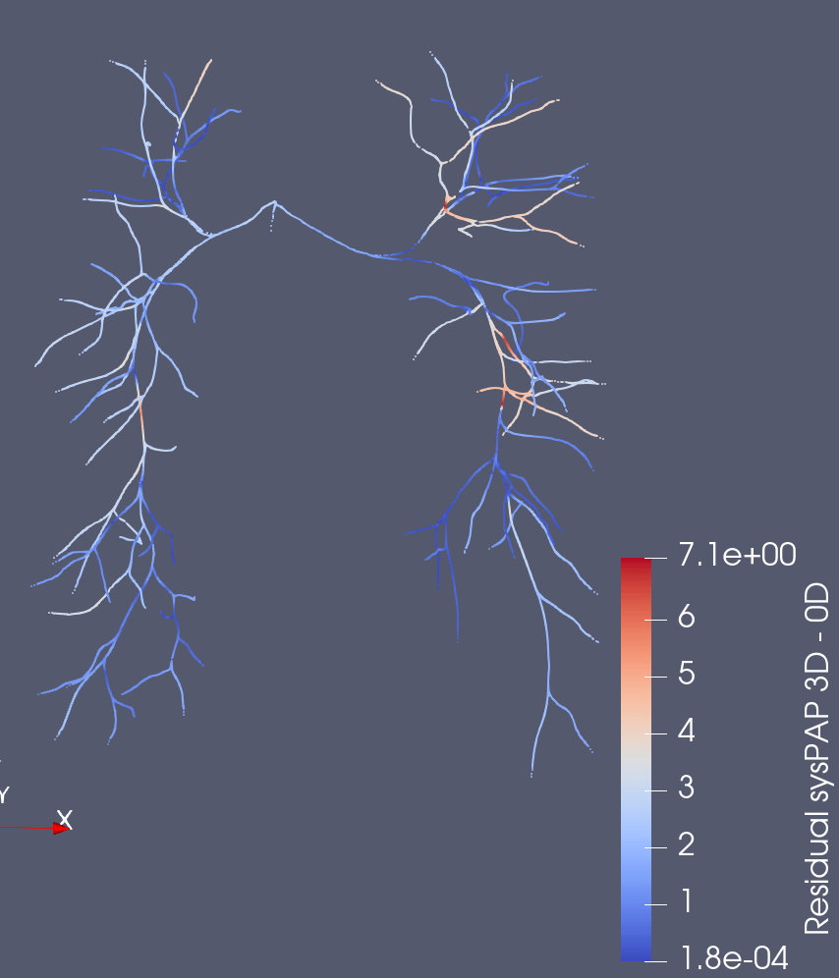
0080_0001 (Residual sysPAP)
Original Solver
Junction Coefficient Solver
Much more consistent

Slide 29
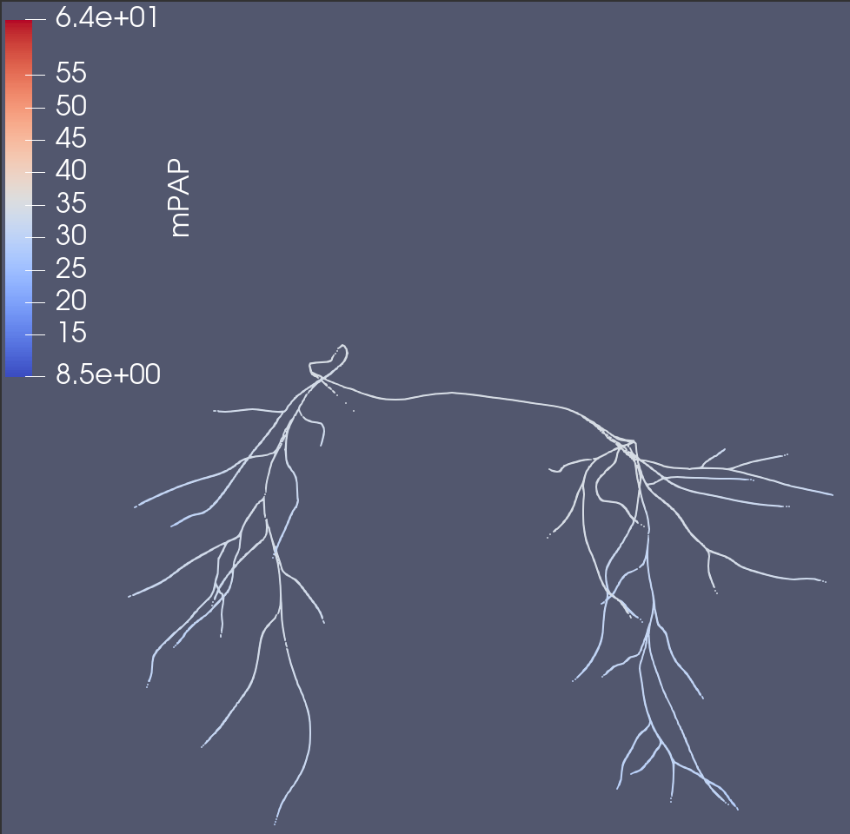
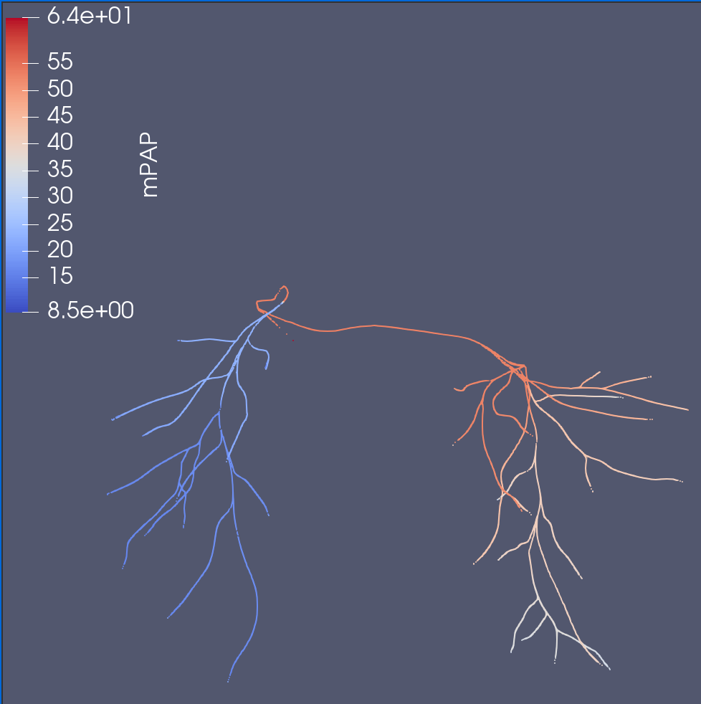
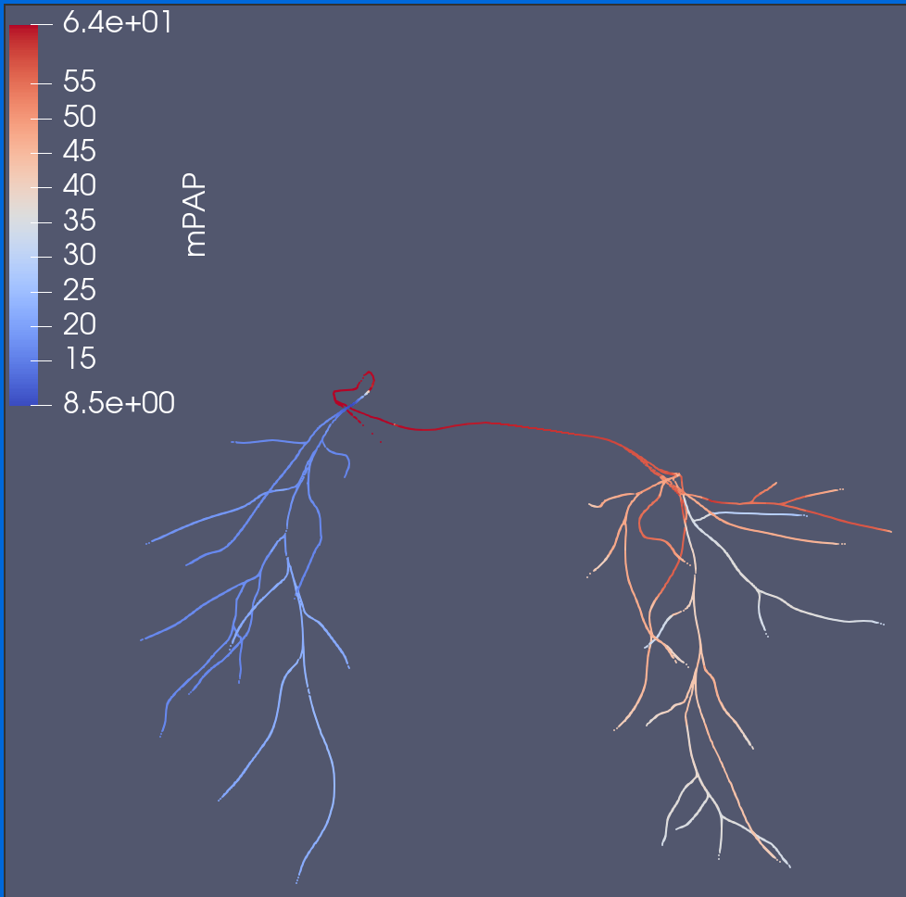
0118_1000 (meanPAP)
Original Solver
Junction Coefficient Solver
3D
Evident that the flow distribution and pressure drop is much more realistic

Slide 30


0118_1000 (Residual meanPAP)
Original Solver
Junction Coefficient Solver
Much more consistent

Slide 31



0118_1000 (sysPAP)
Original Solver
Junction Coefficient Solver
3D
Although JS Solver is unable to fully capture systole, it is far closer.
Not to scale

Slide 32


0118_1000 (Residual sysPAP)
Original Solver
Junction Coefficient Solver
Much more consistent

Slide 33






Formulas
Inlet/Outlet Errors
Pressure Drop (Inlet – Outlet) Errors
$$ε_{P,avg}=\frac{1}{n_{cap}}\sum_{i=1}^{n_{cap}}{\frac{\sum_{t=1}^{n_{t}}{|P_{t,i}^{0D}−P_{t,i}^{3D}|}}{\sum_{t=1}^{n_{t}}{P_{t,i}^{3D}}}}$$
$$ε_{∆P,avg}=\frac{1}{n_{out}}\sum_{i=1}^{n_{out}}{\frac{\sum_{t=1}^{n_{t}}{|{∆P}_{t,i}^{0D}−{∆P}_{t,i}^{3D}|}}{\sum_{t=1}^{n_{t}}{{∆P}_{t,i}^{3D}}}}$$
$$ε_{P,sys}=\frac{n_{t}}{n_{cap}}\sum_{i=1}^{n_{cap}}{\frac{{|P}_{t_{sys},i}^{0D}−P_{t_{sys},i}^{3D}|}{\sum_{t=1}^{n_{t}}{P_{t,i}^{3D}}}}$$
$$ε_{P,sys}=\frac{n_{t}}{n_{cap}}\sum_{i=1}^{n_{cap}}{\frac{{|∆P}_{t_{sys},i}^{0D}−{∆P}_{t_{sys},i}^{3D}|}{\sum_{t=1}^{n_{t}}{{∆P}_{t,i}^{3D}}}}$$
$$ε_{P,dia}=\frac{n_{t}}{n_{cap}}\sum_{i=1}^{n_{cap}}{\frac{{|P}_{t_{sys},i}^{0D}−P_{t_{sys},i}^{3D}|}{\sum_{t=1}^{n_{t}}{P_{t,i}^{3D}}}}$$
$$ε_{P,dia}=\frac{n_{t}}{n_{cap}}\sum_{i=1}^{n_{cap}}{\frac{{|∆P}_{t_{sys},i}^{0D}−{∆P}_{t_{sys},i}^{3D}|}{\sum_{t=1}^{n_{t}}{{∆P}_{t,i}^{3D}}}}$$
$$t_{dia}=arg min_{t}Q_{t, inlet}^{3D}$$
$${∆P}_{t,i}^{dD}=P_{t, inlet}^{dD} −P_{t, i}^{dD}$$
$$t_{sys}=arg max_{t}Q_{t, inlet}^{3D}$$

Slide 34

Quantitative Metrics (3D Relative Errors)
Models | Version | $$ε_{P,avg}$$ | $$ε_{P,sys}$$ | $$ε_{P,dia}$$ | $$ε_{∆P,avg}$$ | $$ε_{∆P,sys}$$ | $$ε_{∆P,dia}$$
0080_0001 | Original | 6.69% | 21.67% | 2.65% | 71.21% | 205.29% | 9.95%
 | JC | 4.90% | 12.31% | 2.69% | 54.49% | 82.33% | 9.79%
0118_100 | Original | 45.19% | 82.68% | 17.02% | 88.13% | 322.63% | 12.93%
 | JC | 19.39% | 43.10% | 6.00% | 48.03% | 196.50% | 5.15%

Slide 35



SU0238 (mPAP)
Original Solver
Junction Coefficient Solver
3D
JC Solver alone is not enough to resolve all problems
Suspect either insufficient number of vessels to capture rapid shrinkage in MPA radius (not a JC Solver problem)
Not to scale

Slide 36


Artificial Stenosis (0080_0001)
Original
JC

Slide 37


Treatment (0118_0001)
Original
JC
Significant change
Similar to previous literature’s ~47% reduction

Slide 38
Goal 1&2 – Next Steps
Temporarily halting progress on stenosis models & focus on Healthy models.
Healthy models offer a target treatment for uncertainty quantification, as well as guarantee that stenosis is in the vessels
Fix up unusable models for more data

Slide 39
Goal 3-6 – Next Steps
Put Clinician meeting on hold
Set up a Neural Network
Inputs:
Vessel Diameter Changes
Outputs:
Tentatively the pressure/flow outs after the diameter change
Discuss with a clinician for more precise outputs
Sobol Sampling to achieve a more even/desired distribution when sampling diameter changes
Training on Notre Dame’s CRC computing cluster

Slide 40



Training Set Generation
Stenosis file
Sobol Sampling ( Must be in orders of 2) w/ dimension n
How many data points do I need
This determines if I need to rewrite the code for memory efficiency, since I currently immediately load all samples in
Save order: (According to txt file ->)
Alternating Pressure, Flow
2 files, input.npy/output.npy files
Potential for speedup. Write directly to some sort of database. Optimizations for multiprocessing.
Input.npy (top)
Output.npy (bottom)

Slide 41
Neural Network
Input (n)
Hidden (3 layers * 1000 Neurons per layer)
Output (2n)
Tanh after each layer
Data
Train: 32k samples (.95, 2.6), Normalized by Mean/Std
Val: 4096 samples (1, 2.6), Normalized using Train data
Test: 4096 samples (1, 2.6), Normalized using Train data
Huber-Loss
Batch size = 128
Adam, lr = 1e-3, ReduceLRonPlateau, EarlyStop. Record best “val_loss”

Slide 42



Slide 43

Worst Error

Slide 44


Slide 45
Notes
Pushed edge error below (more data to compensate for 50% reduction in data)
Tanh > Sigmoid > ReLU -> no need for Regularization.
Results:
All Errors < .05 mmHg

Slide 46
Probability
Ability to sample from data with given fail, moderate, success
Options of Fixed, Random/Frozen, where Fixed samples the true value and Frozen samples the lowest (1.0)
Can generate any number of samples & feed it in large batches < 1 sec to execute 4000+.
Generate a histogram for each stenosis point

Slide 47
Optimal Route
1st Order (Total O(n^2)
For each fixing step (i of n steps):
For each point (j of n - i):
Sample 1000 samples, freezing all but j random point.
Construct Distributions
Compute (Target Function)
Compute Optimal point j to fix
^{2nd} Order (Total O(n^3))
For each fixing step (i of n steps):
For each point (j of n - i):
For each point (k of n – i - 1):
Sample 1000 samples, freezing all but j and k random points.
Construct Distributions
Compute (Target Function)
Compute Optimal point j to fix (Target Function)

Slide 48
Target Function
If we know the Final Target (like with a healthy model) then we can compute a distance function/improvement function from that point
Otherwise, we could do a relative improvement (We lose out on knowledge of which improvements we want to prioritize)
Some combination?

Slide 49
Questions for Clinician
Procedure
What is the procedure?
How do you measure the bp? (Catheters are expensive)
How do you define successful procedures?
How do you decide where to fix?
More Specific
How would you quantify best points to fix?
What are probabilities for fixture (is there a difference for different generations)?
Is there a max # of generations fixable?
What would be helpful questions?
Reasonable way to enter desired points?

Slide 50






Thank You!

